Slide 1
Capstone project presentation
By Nupur Saboo

Slide 2
Table Of Content
Introduction
Business Problem
Data
Methodology
Results
Conclusion

Slide 3
Introduction
Paris is the most popular city in France with an estimated population of about 2 million people as of 2020 in about 150 sq. kilometers.
Paris is also one of the most desirable tourist destinations in the world. It is known as the city of love and is widely known for its fashion sense, pastries and cafes.
Corner shops and popular streets are ideal to set up a café, but to succeed with yet another café in a market with such high competition, one must provide affordable and delicious looking merchandise, to notch services and have a unique ambiance which people will not find easily elsewhere.

Slide 4
Business Problem
People working on projects need a place to sit where they can consume beverage such as tea, coffee etc. and eat fast food that does not require the use of both hands and is not very messy or time consuming.
The aim will be to set up the café in a place which attracts a lot of people, thereby allowing owners of the outlets to earn maximum profit out of them.

Slide 5
Data
Neighborhood
The data for neighborhoods in Paris was extracted by web scraping using BeautifulSoup library for Python. The neighborhood data is scrapped form the Wikipedia page.
Geocoding
The geometric location and values are stored into the data frame using this.
Venue data
Venue data is found by passing the required parameters in the Foursquare API and creating a data frame to contain all the details.

Slide 6
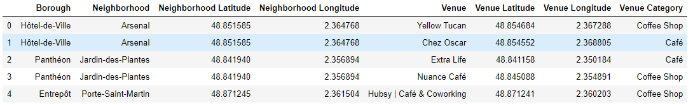
Methodology
One hot encoding
It is a process by which categorical variables are converted into a form that could be turned into ML algorithm to improve predictions.
Folium
All cluster visualization is done using folium which in turn generates a map.
K-means- clusters

Slide 7
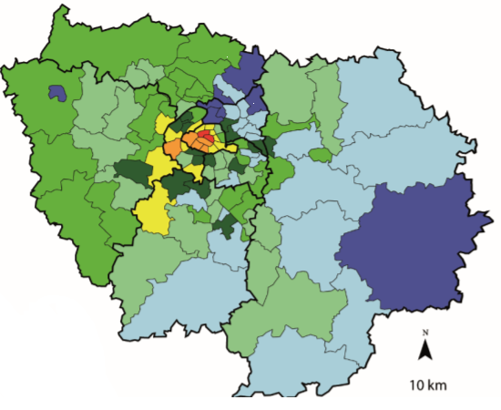
Population distribution in Paris shown in different colors for easy distinction.

Slide 8
Results
The neighborhoods are divided into n clusters. The clustered neighborhoods are seen using different colors to make them distinguishable.

Slide 9
Conclusion
Montmartre is the best location for cafes as it has a high population is close to some major tourist spot, but because of high competition in that region from the already existing cafes, Belleville will be a more suitable place to set up a new café.

